Slide 1
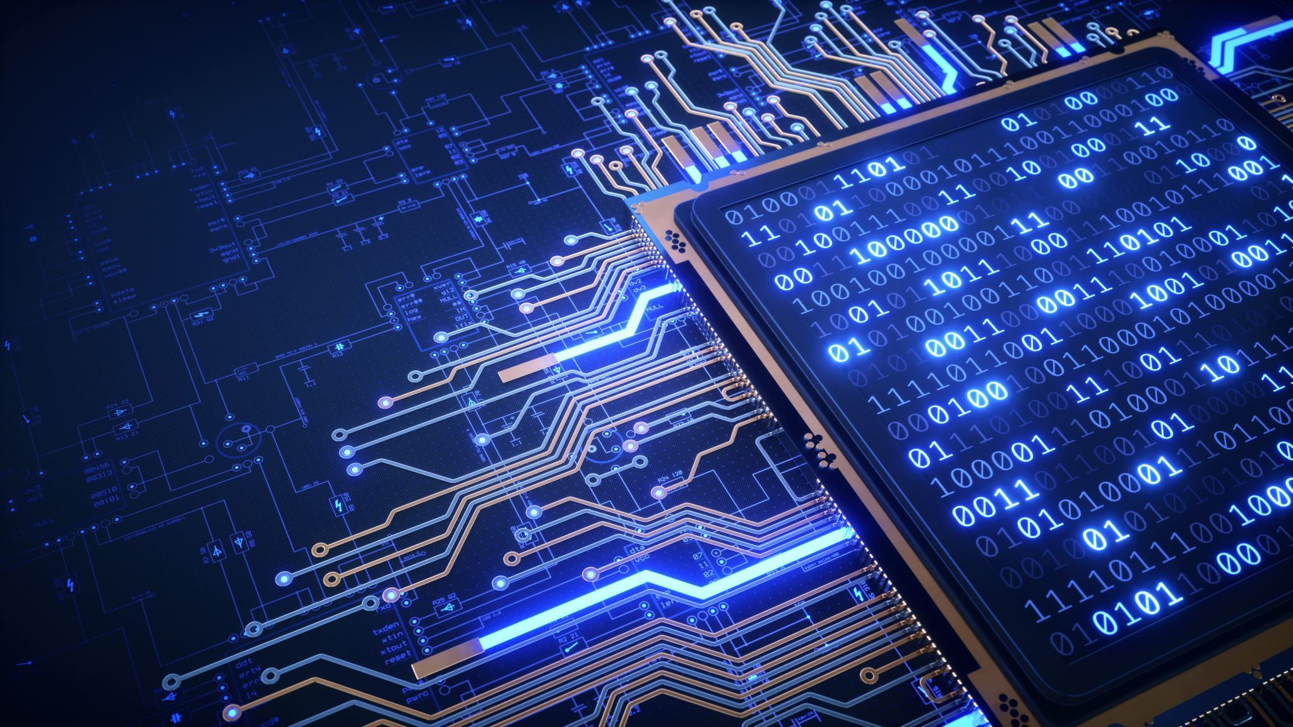
Overview of Machine Learning and Natural Language Processing in Chatbots
Mihir Hundiwala
1911082

Slide 2

Overview
.

Slide 3

What is a chatbot ?
A conversational Automated Computer Program
capable of taking a natural language input
and providing a conversational
output in real time.
It simulates human conversation through voice commands or text chats.
Chat-bot
Conversation
+
Automated computer program

Slide 4



Why we need chatbots?
Increase in Internet Usage
Increase in E-commerce
Online Businesses
Large number of requests and queries
Immediate response
24/7 service
Low cost and maintenance

Slide 5
History of Chatbots
ELIZA was the very first chatbot created by Joseph Weizenbaum in 1966 which used ruled-based approach.
First Generation [ELICE, PARRY, etc.] of chatbots were based on predefined rules.
If a client says this then the chatbot replies with this.
The second generation of chatbots introduced NLP and were able to answer multiple questions where one question could be answered in context of the previously answered questions.
ALICE ( Artificial Linguistic Internet Computer Entity ) uses Pattern-Matching technique.
Third Generation can interact through text and voice as well.
21st Century Virtual Assistants like,
Siri by Apple
Cortana by Microsoft
Google Assistant
Alexa by Amazon

Slide 6
Characteristics of a Chatbot
Development of chatbots went from
pattern matching and simple “Q&A” to carrying out and continuing
more humanly conversations.
Expectations from advanced chatbots raised from
not only to answer but also to
learn and improve themselves with each conversation .
Study of characteristics of such smart bots needs to be done.
What characteristics ?
Understanding natural language input.
Dialogue management.
Responding with natural language.
Security

Slide 7

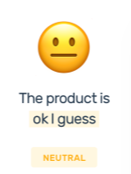
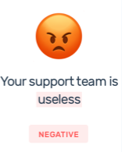
Characteristics of a Chatbot
Understanding natural language input
Natural Language Processing coupled with Machine Learning is used to tackle
the two most common problems in computational linguistics (a branch of linguistics in which computer science techniques are used for analyzing language).
A. Sentiments Analysis or opinion mining :
Identify the sentiments from the information input.
Determine whether a piece of writing is positive, negative or neutral.
Used by businesses to detect sentiment and understand customers.
Understand the tone, emojis, context of inputs.
What did you like about the event?
1. Everything of it.
2. Absolutely nothing!
What did you dislike about the event?
1. Everything of it.
2. Absolutely nothing!

Slide 8
Characteristics of a Chatbot
Understanding natural language input (contd.)
B. Text similarity :
Morphological similarity → respect-respectful (same root, noun-adjective)
Spelling similarity → center-centre, theatre-theatre
Synonymy → talkative-chatty,
Homophony → see-sea, fare-fair, some-sum
Sentence similarity → the plane leaves at 12 pm –
the flight departs at noon
etc.

Slide 9
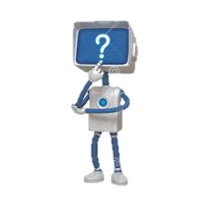
Characteristics of a Chatbot
2. Dialogue Management
After understanding the user input,
the DM stage should determine a response
based on the context of the conversation.
In simple words, the dialogue management stage
classifies the question type and
determines the relevant category of answers
the chatbot can use for responding.

Slide 10
Characteristics of a Chatbot
Responding with Natural Language
After determining the category of relevant answers, the chatbot must then:
Construct a relevant, personalized response using natural language.
Immediate response.
Personalized : Writing Styles and Emotions.
The responses generated by the chatbots should be grammatically correct and exhibit human-like behaviours and emotions.
Immediate : Realistic and Fast Response.
Ideally, if the user’s question requires searching through the internet, the chatbot should search and respond as quickly as most search engines.
Security
Security features should be applied to all the data in the chatbot databases for user security and privacy.

Slide 11
Early Approaches used in development of Chatbots
Pattern-Matching:
Used in question-answering bots.
Such chatbots use a knowledge base which
contains documents and each document
comprises a particular <pattern> and
<template>.
When the bot receives an input that matches
the <pattern>, it sends the message stored in
the <template> as a response.
Typically, these <pattern> <template>
pairs are manually inserted.
# Pattern Matching
<category>
<pattern>What the user says</pattern>
<template>What the bot responds</template>
</category>
#PRE_STORED PATTERNS
<category>
<pattern>The capital of the Russia?</pattern>
<template>The capital of the Russia is Moscow.</template>
</category>
<category>
<pattern>The capital of India?</pattern>
<template>The capital of India is New Delhi.</template>
</category>

Slide 12
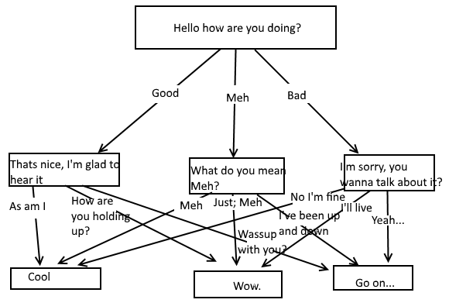
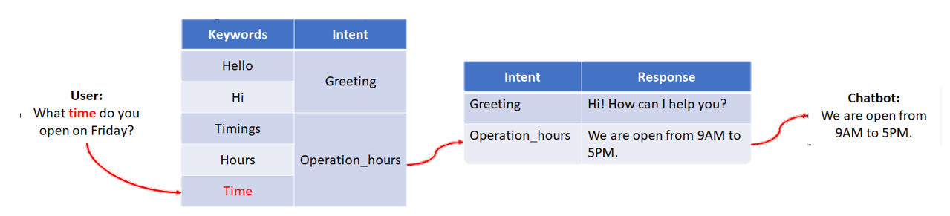
Early Approaches used in development of Chatbots
2. Rule-Based:
The input is transformed into a “keystack,”
The keyword of the highest rank is used to determine the category of responses most related to the keyword.
This helps the bot determine a relevant response.
They are able to answer multiple questions where one question could be answered in context of the previously answered questions.
I am doing :

Slide 13
Machine Learning Approaches
This section discusses existing modern NLP techniques that can be used when developing a chatbot.
Recently, NLP techniques have been combined with ML, as ML improves the chatbots’ performance of finding patterns from large amounts of data.
The current stages of NLP and ML techniques applied in the field of chatbot model development :
Data Pre-processing
Retrieval Based
Generation Based

Slide 14
Machine Learning Approaches
Data Pre-processing
Arbitrary user input data may not be “clean”. Clean data is the data a chatbot can understand.
Cleaning involves removing of punctuations and symbols.
Next step is tokenization. Tokenization involves breaking down sentences into words.
Stopwords removal. Stopwords are the words that do not hold much value in a sentence. E.g. I, am, you, the, and etc.
Removal of these words improves efficiency.
Stemming
Lemmatization

Slide 15
Machine Learning Approaches

Slide 16
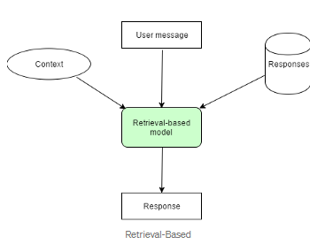
Machine Learning Approaches
Retrieval Based
Retrieval based bots are the most common types of chatbots.
This approach is used for short text conversation chatbots.
The chatbot is trained to provide the best possible response
from a database.
The database consists of short conversations on social media
like Q&A forums.

Slide 17
Machine Learning Approaches
C. Generation Based
As the name suggests “Generative” in this approach, the chatbot doesn’t use any sort of predefined repository, they can generate a response by itself.
The model predicts the next sentence in a conversation given the previous sentences using Recurrent Neural Networks.
RNNs are a type of AI network commonly used in NLP. They are designed to recognize and use patterns to predict the
next likely scenario.
Chatbots that use generative methods can generate new dialogue based on large amounts of conversational training data.
This type of chatbot is very rarely used, as it requires the implementation of complex algorithms. Training of this type of bot requires investing a lot of time and effort.
These methods are still in research.

Slide 18
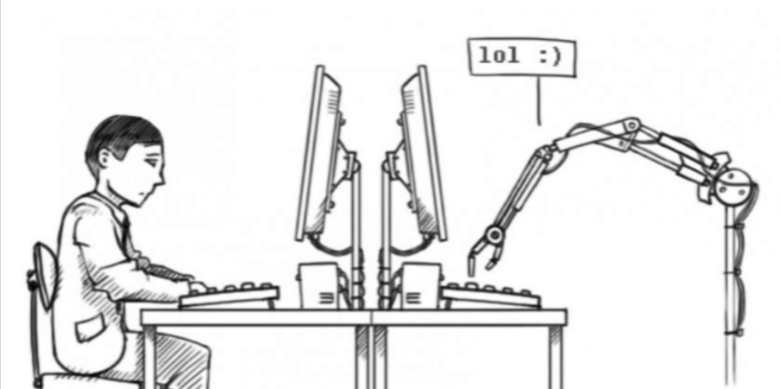
Ultimate Goal
From Chatbots Perspective, its ultimate goal is to pass the Turing test.
Alan Turing, one of the most prominent breakers of German code, issued an open challenge to the computer scientists of the world.
It came to be known as the Turing Test.
Turing challenged scientists to create a program that would be indistinguishable from a human in a Natural Language conversation.
A panel of human judges would converse anonymously, in text form, with a computer program and also with a human operating a computer.
Chatbot should be capable enough not to reveal itself among the

Slide 19
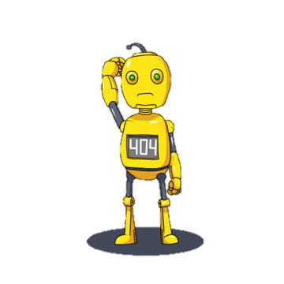
Challenges
Message Interpretation:
Different people have their own way of typing a message.
- How long should bot wait to understand human?
How many chat should a bot club together to understand human response?
Context
Natural Language Processing: The current state of natural language Processing is not that advanced to tackle everything.
- What about mixing of local language, the words and slangs
- Sarcasm, irony
Chatbot Style:
User attention span is limited and often users are very distracted, so it is not only that we understand them
- Grab users attention.
- Creative Response.

Slide 20

Conclusion

